Slide 1
Trace Processing for
Exploiting Architecture Designs
Prof. Chung-Ta King
Department of Computer Science
National Tsing Hua University, Taiwan
(Coworks with 李荏敏、王泰元、廖柏皓、蔡昕潔)

Slide 2
Outline
Why trace-driven simulation for exploiting architecture designs?
Dependence-aware trace: why and how
Dependence-aware trace-driven simulation for SMP NoC
Dependence-aware trace-driven simulation for GPU NoC
FSM-based trace compression

Slide 3
Simulation for Architecture Designs
Functional simulation (e.g., QEMU, HSAemu)
  Achieve same function as modeled machine (emulation)
  Often can run OS and applications on top of the simulator and obtain the same execution results
  Extensively apply binary translation for speed
Timing simulation (e.g., Gem5)
  Accurately reproduce the performance/timing features of the modeled machine in addition to its functionalities
  Cycle-accurate/-approximate
  Execution-driven simulation
  Trace-driven (TDS) or event-driven simulation

Slide 4
Simulation for Architecture Designs
Full-system simulator (e.g., QEMU, Gem5)
  A simulator that simulates a machine at such a level of detail that complete software stacks (device drivers, OS) from real systems can run without any modification
  Effectively provide virtual hardware that is independent of the host computer
  Typically include processor cores, peripheral devices, memories, buses, and network connections
Cycle-accurate simulator
  A computer program that simulates a microarchitecture (processor, cache, NoC, …) on a cycle-by-cycle basis

Slide 5
Trace-Driven Simulation
Simulations that use time-ordered record of events collected from real machines or emulators as input and simulate operations of specific modules
Example: want to simulate NoC of target machine
Normal execution-driven simulation:
need to simulate operations of processors and memory
P
P
P
P
Interconnection Network
Memory

Slide 6
Trace-Driven Simulation
Simulations that use time-ordered record of events collected from real machines or emulators as input and simulate operations of specific modules
Example: want to simulate NoC of target machine
  Use trace instead of simulating operations in proc./mem.
trace
trace
trace
trace
Trace events: injections of memory requests and replies
Interconnection Network
trace

Slide 7
Two Phases of Trace-Driven Simulation
Trace generation
Target
arch. def.
Program
Trace-generating machine
Trace-driven simulator
Simulation
output
Trace
Notes:
Full-system simulator, runtime instrument tool, emulator

Slide 8
Two Phases of Trace-Driven Simulation
Trace-driven simulation
Target
arch. def.
Program
Trace-generating machine
Trace-driven simulator
Simulation
output
Trace

Slide 9
Trace-Driven Simulation
Trace-driven simulation has been an important tool for exploiting design space of computer architecture
Advantages:
  Speed (no need to simulate operations in cores)
  Can focus on specific components (uncores such as cache, NoC, and memory)
  Easy to develop
Disadvantage:
  Inaccurate timing

Slide 10
Outline
Why trace-driven simulation for exploiting architecture designs?
Dependence-aware trace: why and how
Dependence-aware trace-driven simulation for SMP NoC
Dependence-aware trace-driven simulation for GPU NoC
FSM-based trace compression

Slide 11
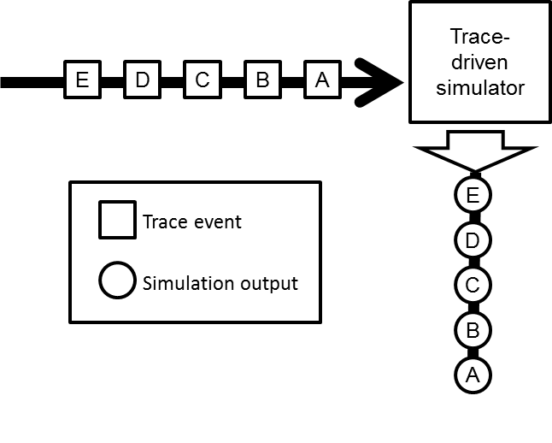
Why Trace-Driven Simulation Inaccurate?
Traditional trace-driven simulation
  Trace events are fed to simulator according to their time of occurrence obtained from trace-generating machine
  Timing of trace events is that of trace-generating machine and is fixed regardless of the target machine

Slide 12
Why Trace-Driven Simulation Inaccurate?
Execution time of target machine might not be the same as that of trace-generating machine
  e.g., different ISA, microarchitecture, implementation, ...
Even if have the same processors on both machines, simulation of NoC will necessarily change the configuration and/or microarchitecture of the NoC
  The response time from NoC will be different on target machine and on trace generating machine
  However, trace events actually have causality relationships
  → changes in NoC response time change following events
  → timing of trace events should be adjustable

Slide 13
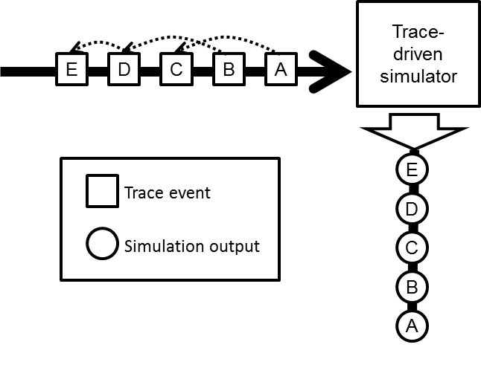
Why Trace-Driven Simulation Inaccurate?
There are dependencies between trace events, e.g.,
  C has to wait for A’s response, D for B, and E for D
  Response time of events A, B, C differ from that in trace-generating machine → injection time of C, D, E should be adjusted during simulation

Slide 14
An Illustrative Example (NoC Simulation)
On trace-generating machine
Simulator
Output
Program
Trace Record
NoC
LD r1, 0xcfa8
...
ADD r0, r1, #2
...
ST r0, 0xcfac
Event A, T_{A}
Event A’, T_{A’}
Event B, T_{B}

Slide 15
An Illustrative Example (NoC Simulation)
On target machine with a slow NoC
Simulator
Output
Program
Trace Record
NoC
LD r1, 0xcfa8
...
ADD r0, r1, #2
...
ST r0, 0xcfac
Event A, T_{A}
Event A’, T_{A’}
Event B, T_{B}

Slide 16
To Make Trace-Driven Simulation Accurate
Track causality dependencies between trace events
Core and uncore models are coupled and interactive
  Input trace events should interact with simulator output events → trace event time closer to that in target machine
D
C
trace
trace
trace
trace
B
A
More complicated event relationships if consider processor-memory interactions
A
Interconnection Network
B
C
D
trace
Notes:
也就是說對於trace-driven simulator 就是input stream要跟 output stream溝通

Slide 17
Previous Work
Netrace: dependence-aware trace-based NoC simulation
  Capture dependencies between network messages observed in full-system simulation
  Classify dependence relationships among system events
    Architectural dependency
    Micro-architectural dependency
    Data/Instruction flow dependency
  Provide a library to transform a trace-driven simulator to track and replay network messages with dependencies
Joel Hestness, Boris Grot, and Stephen W. Keckler. Netrace: Dependency-driven trace-based network-on-chip simulation. In Proceedings of the Third International Workshop on Network on Chip Architectures, NoCArc ’10, pages 31–36, New York, NY, USA, 2010. ACM.

Slide 18
Three Types of Dependencies
Data/instruction flow dependency
  Due to data- and control-flow dependencies within an application, realized by processor microarchitecture
LD r1, 0xcfa8
ADD r0, r1, #2
ST r0, 0xcfac
Trace event A
Trace event B

Slide 19
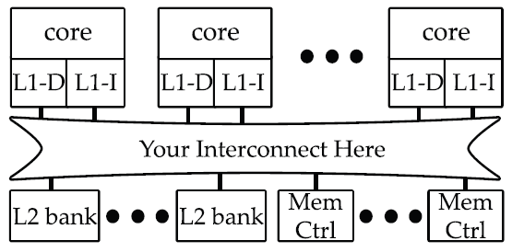
Three Types of Dependencies
Architectural dependency
  Due to architectural component interaction, e.g., messages between cores, caches, memory controllers
  Request-request, request-response, response-response
Target machine

Slide 20
Three Types of Dependencies
Micro-architectural dependency
  Due to microarchitectural implementation details, e.g., buffer capacities, cache coherence protocol, etc.
  New system events caused by trace events
Target machine

Slide 21
Outline
Why trace-driven simulation for exploiting architecture designs?
Dependence-aware trace: why and how
Dependence-aware trace-driven simulation for SMP NoC
Dependence-aware trace-driven simulation for GPU NoC
FSM-based trace compression

Slide 22
How Effective Is Dependence-aware Trace?
Our proposal:
  Compare dependence-aware trace-driven simulation with full-system simulation
Focus on NoC simulation (average latency)
  Gem5 as the reference: Gem5 uses Ruby memory system model, which in turn supports Garnet network model
  Standalone Garnet as trace-driven simulator
CPU system model
Trace event
。。。
Dependence-aware trace-driven NoC simulator
L1
L1
L1
Gem5
NOC model: Garnet
Standalone Garnet
Memory model: Ruby
Simple memory model

Slide 23
Evaluation Flow
Trace format
parser
Program
Config def.
Gem5
NoC Trace
Standalone Garnet
Performance
result
Config def.
Dynamically update timing
Notes:
Trace driven 分成兩個phases,
在trace generation 時候，我們用 full system 去插code 記錄下trace,
經過parser 留下想要的資訊，再將trace 餵進一個trace driven 的 simulator.

Slide 24
Issues to Resolve
For Gem5:
  Filter log from Gem5 to extract NoC events
  Match messages and the constituent flits to get latency
  Match request and response messages for round-trip time
For dependencies among trace events
  Use the ROB model
For standalone Garnet:
  Generate traffic based on trace events, not random func.
  Generate round-trip messages, not just source-destination
    Need to model cache/memory and their responses, inject response messages back to NoC, match request-response

Slide 25
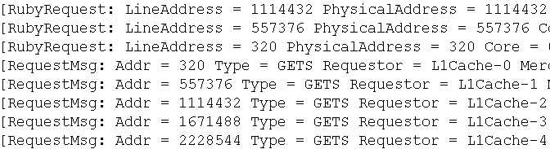
Trace Extraction from Gem5
Message flow in Gem5
  Dump message logs from message buffer to trace file
core
RubyRequest
L1 cache
If miss
RequestMsg
Garnet
ResponseMsg
L2/Mem
Notes:
在trace generation 部分，左邊的圖為message 的運行流程，CPU如果需要資料的時候，會發出一個rubyrequest，如果 L1 hit 的話，就會結束. 如果miss 的話L1就會發出一個 request msg進入NOC，L2 發出response msg將資料回應

Slide 26
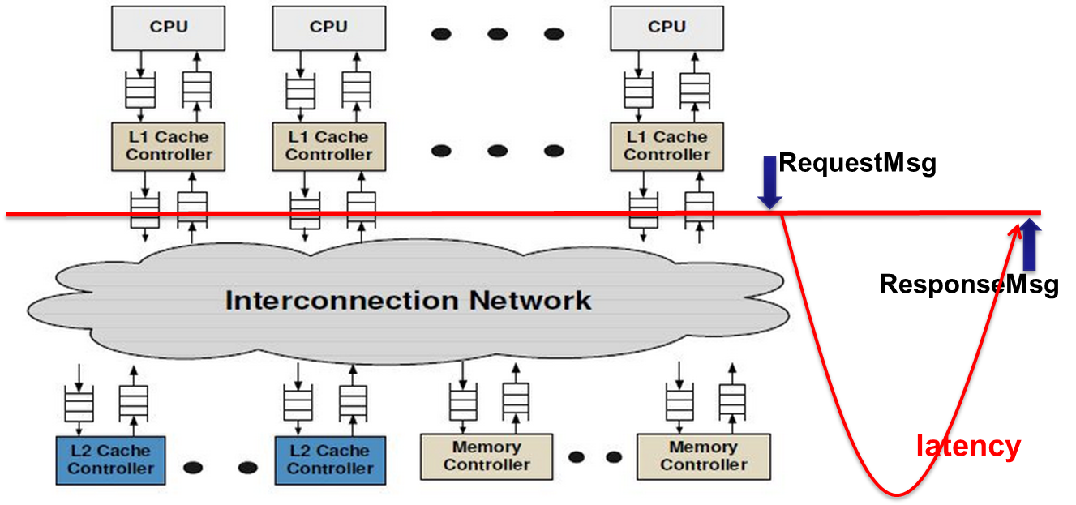
Trace Extraction from Gem5
Also record the latency between response message and corresponding request message
Filter the full trace so that each trace event includes:
  Message type
  Address
  Source
  Time
Notes:
我們的trace 會記錄 L1 issue request 時間和 response msg 回應的時間。
將full trace 的內容parse後 留下 message type，address，source，time。

Slide 27
Standalone Garnet Modifications
Garnet was developed as an interconnection network simulator and later integrated into Ruby
  Input packets are generated using random number generator based on user-specified injection rate
  Concern mainly on packet delivery performance from source to destination (not specific about their roles)
For our evaluation
  Need to generate traffic to standalone Garnet based on trace events → modify Garnet, determine message size
  Need to model memory and round-trip traffic between L1 and memory
Notes:
Garnet standalone 是一interconnection network simulator，但是garnet 產生封包的方式是根據injection rate 並使用random的方式，所以我們要將它改成根據trace 的時間點發送封包，第二個問題是， garnet 是一個one way 的simulator，從 L1 cache 產生封包根據address 送到一個directory，沒有實作從目的回應封包的機制，
也就是說沒有像full system中的response msg。

Slide 28
Determine Size of Messages
Flow in Gem5 from a request at application-level down to HW flits
2 possible message types from Gem5
  Number of flits = 1
  Number of flits = 5
3 types of messages in standalone Garnet
  RubyRequestType_LD : num_of_flit =1
  RubyRequestType_IFETCH : num_of_flit =1
  RubyRequestType_ST : num_of_flit =5
Based on event message type in trace file,
create request type and size for the message
Request
Packet
Message
Flit

Slide 29

Inject Memory Responses into NoC
Garnet must inject messages not only from L1 trace events but also from memory responses
Request buffer
core0
core1
core2
core(N)
core(N+1)
Garnet standalone simulator
Response buffer
dir0
dir1
dir2
dir(N)
dir(N+1)
Notes:
因此我們必須自己實作 response function ，每個core 會有自己的request buffer，當simulator的 tick 數到trace event送出的時間，會送出trace，garnet standalone 只負責把封包送到目的，但是沒有回應機制，所以我們必需將message 的資訊(source destination)，在new 一個message從 destination送回來。

Slide 30
Match Request and Response Messages
Messages are divide into flits for delivery in NoC
  Must know id of request message that sent these flits so that memory can reply response message to that request
Solution to carry message id downward:
  Use unused space in message address field
RubyRequest.Address (uint 64 bit)
54bit | 4bit | 6bit
Dest
Block offset
Cache line address

Slide 31
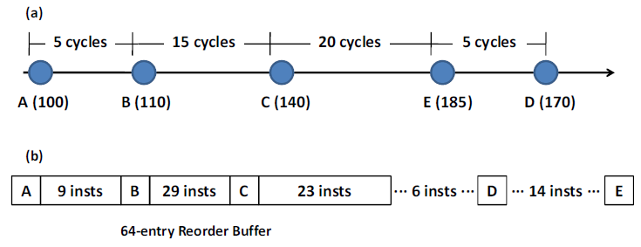
Dependencies among Trace Events
Based on the independent cache miss model:
  All the L1 misses in ROB are independent
  The only restriction on how many L1 misses can be issued is the ROB size
Kiyeon Lee , Shayne Evans , Sangyeun Cho, “Accurately approximating superscalar processor performance from traces”, ISPASS 2009.

Slide 32
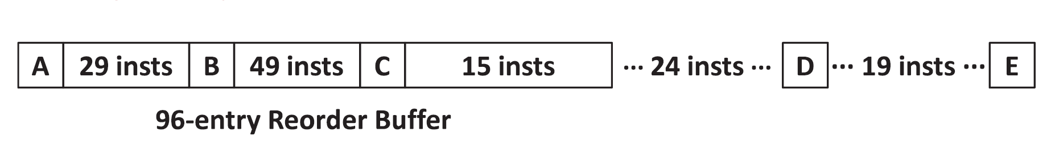
Independent Cache Miss Model
A, B, C can be issued together in the beginning
The distance between A and D are over 96 instructions, so D depends on A
By the time A commits, D can be issued when the 24 instructions ahead are in ROB
However, the instructions between B and E are still over 96, hence, so E depends on B
E will finally enter the ROB after B commits

Slide 33

Evaluation
Trace
Trace’
Update timing
Gem5
full system
Garnet
standalone
Config A.
Config B.
L1 cache
miss penalty
L1 cache
miss penalty
Average miss penalty should
be close to that of full system!

Slide 34
Can Use Standalone Simulator w/o Change?
If we have dependence-aware trace and an ordinary dependence-unaware trace-driven simulator …
We must have a thorough understanding of the simulator to use the Netrace library or modify the simulator for dependence awareness, requiring a lot of efforts …
Can we allow ordinary dependence-unaware simulator to leverage dependence-aware trace to improve its accuracy?

Slide 35
Observation
Traditional trace-driven simulators are batch-processing → generates simulation output only when simulation finishes, but
  Dependence-aware trace works if core-uncore interactive
D
C
trace
trace
trace
trace
B
A
A
Interconnection Network
B
C
D
trace

Slide 36
Motivation
Batch-processing trace-driven simulator cannot leverage dependencies in trace events
If we do not want the modification efforts to transform a batch-processing simulator into an interactive simulator, what can we do?
How about using the simulation output to correct input trace timing based on dependencies?

Slide 37
Basic Ideas
To do so, we need to dump the reference time of the output on the trace-generating machine so as to compare with that from the simulation output
Round 1
Trace-driven simulator
E
D
C
B
A
E
Timing
reference
D
C
B
A

Slide 38
Basic Ideas
On trace-generating machine: dump simulator output events, not just performance statistics
Simulator
Output
Program
Trace Record
NoC
LD r1, 0xcfa8
...
ADD r0, r1, #2
...
ST r0, 0xcfac
Event A, T_{A}
Event A’, T_{A’}
Event B, T_{B}

Slide 39
Basic Ideas
Also, a timing corrector to decide how to adjust timing in timing reference
Round 1
Trace-driven simulator
E
D
C
B
A
E
Timing
reference
D
Timing
corrector
C
B
A

Slide 40
Basic Ideas
In trace-driven NoC simulation
Simulator
Output
Program
Trace Record
NoC
LD r1, 0xcfa8
...
ADD r0, r1, #2
...
ST r0, 0xcfac
Event A, T_{A}
Event A’, T_{A’}
A’
Event B, T_{B}

Slide 41
Basic Ideas
Changes in timing reference affect timing of input trace events through dependencies
  Update timing of input trace events and timing reference
Round 1
Trace-driven simulator
E
D
C
B
A
Closer to that of target machine
E
Timing
reference
D
Timing
corrector
C
B
A

Slide 42
Basic ideas
The same procedure is repeated until output event timing converges
Round 2
Trace-driven simulator
E
D
C
B
A
E
Timing
reference
D
Timing
corrector
C
B
A

Slide 43
Simulation Flow
The first round uses timing from trace-generating machine, so result is same as original simulator
Trace-driven simulator should output simulated events, not just performance statistics and metrics
Need to determine when the event timing converges so that the iterative process can be stopped
Full-system simulator
Trace event
Trace-driven simulator
Simulation
output
Trace event
Dependence-aware trace
Update timing
Program
Timing reference
Timing
corrector
No
Yes
Simulation
finished
Converge?

Slide 44
For This Study
gem5
Trace event
booksim
Simulation
output
Trace event
Dependence-aware trace
Update timing
Program
Timing reference
Timing
corrector
No
Yes
Simulation
finished
Converge ?
Focus on interconnection network

Slide 45
Dependence-aware Trace
In booksim, input trace events are L2 misses
In order to build dependencies among trace events, we have to recognize the serial number (ISN) of the instructions causing L2 misses
To do so, we have to dump the instruction traces and feed to a cache model to obtain the ISN
The dependencies are built based on the independent cache miss model
  All the L1 misses in ROB are independent
  The only restriction on how many L1 misses can be issued is the ROB size

Slide 46
  Timing Reference
Timing reference records the response time of all L1 cache misses in trace-generating machine
In each round, timing reference is sent to timing corrector
After updated timing is computed, response time is used to update timing reference for the next round
Full-system simulator
Trace event
Trace event
Dependence-aware trace
Program
Timing reference
Timing
corrector

Slide 47
Timing Corrector
Timing corrector uses information from simulation output and timing reference to correct timing of input trace events
In timing corrector, a virtual ROB is updated cycle-by-cycle
Trace event
Trace-driven simulator
Simulation
output
Trace event
Dependence-aware trace
Update timing
Timing reference
Timing
corrector
No
Yes
Simulation
finished
Converge ?
[2] In-N-Out: Reproducing Out-of-Order Superscalar Processor Behavior from Reduced In-Order Traces (MASCOTS 2011)

Slide 48
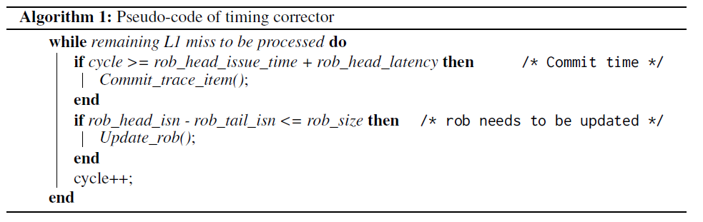
Timing Corrector
When the rob_head reaches commit time, we commit trace and set the new rob_head
If free entries are enough to accommodate next trace, we issue it and compute the trace injection time base on timing reference

Slide 49
Discussion
Our proposed methodology is to feed the traces through ordinary simulators several rounds
If all trace events are in the critical path of the execution, we have to loop as many times as the number of trace events in the worse case
Observation shows that most of the trace events are not in the critical path, and thus the timing can be converged very soon

Slide 50
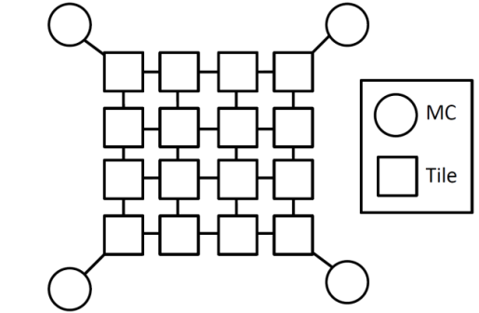
Experiment Setup
Gem5 with 16 out-of-order cores, single-threaded and tiled-base as baseline
Garnet in Gem5 as reference
Booksim as dependence-aware
trace-driven simulator
  Parameters in Booksim are set same as those in Garnet
Benchmark suite from SPEC2006 is used and each core runs on copy of the program
Target architecture

Slide 51
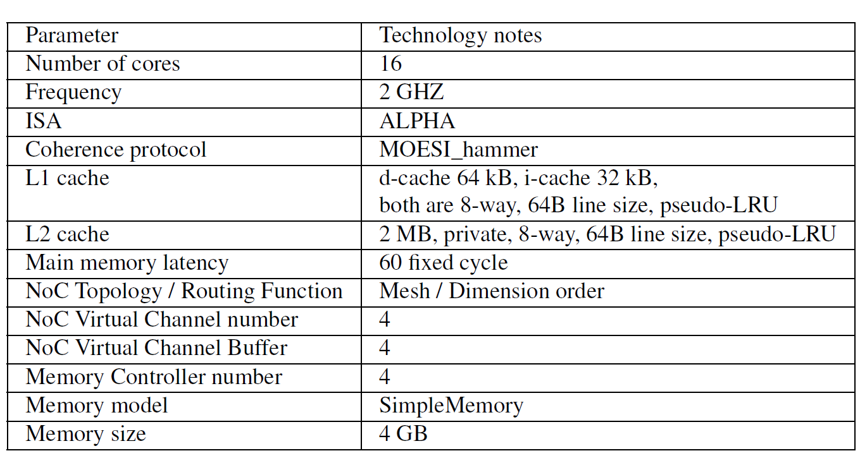
Experiment Setup
Microarchitecture parameters

Slide 52
Metrics Used
Network latency error
Converge ratio

Slide 53
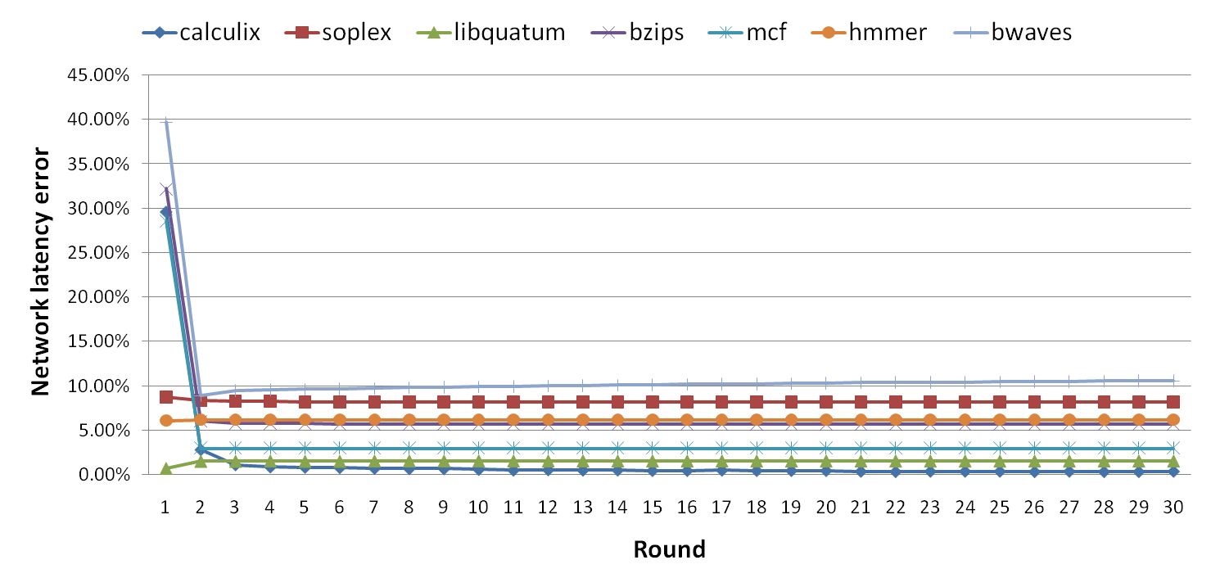
Convergence
We run each benchmark for 30 rounds
Most of benchmarks converge after 5 rounds

Slide 54
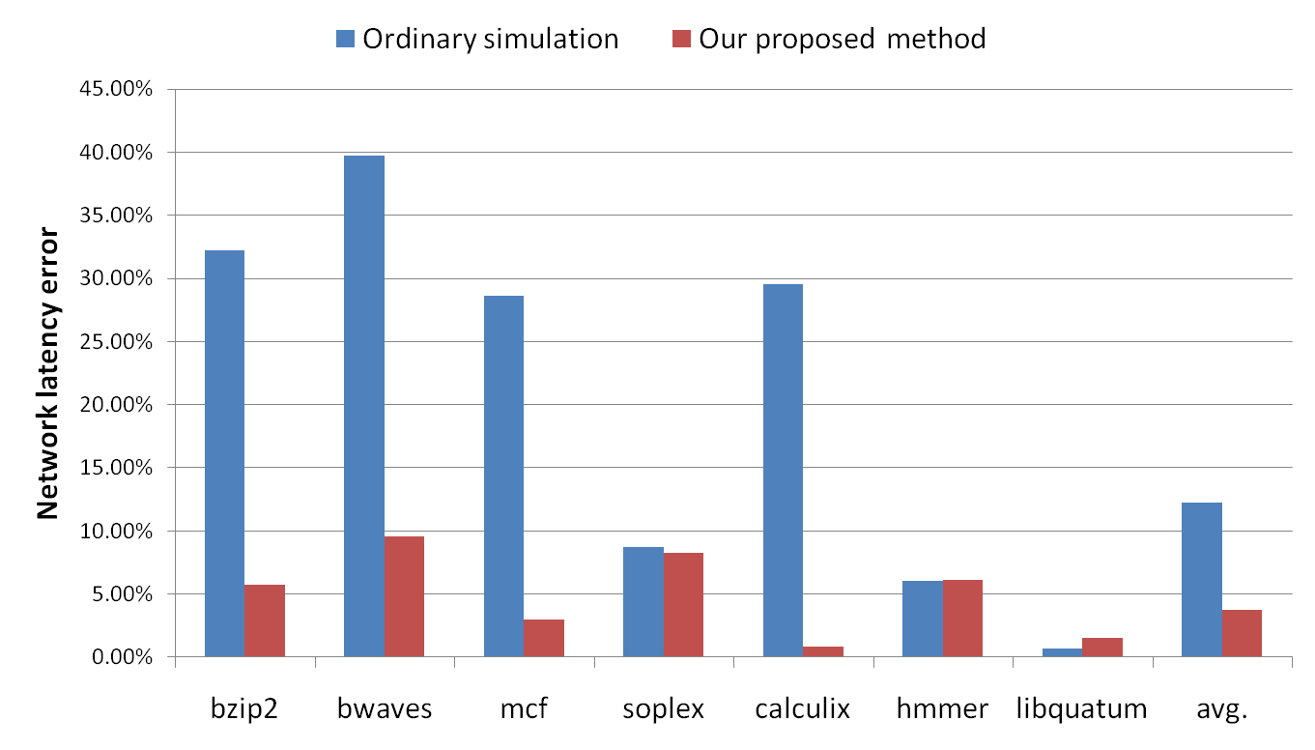
Accuracy
These four benchmarks have relatively higher cache miss rate

Slide 55
Accuracy
These three benchmarks have relatively lower cache miss rate.
One source of discrepancy is that the independent cache miss model does not consider the dependency in ROB.

Slide 56
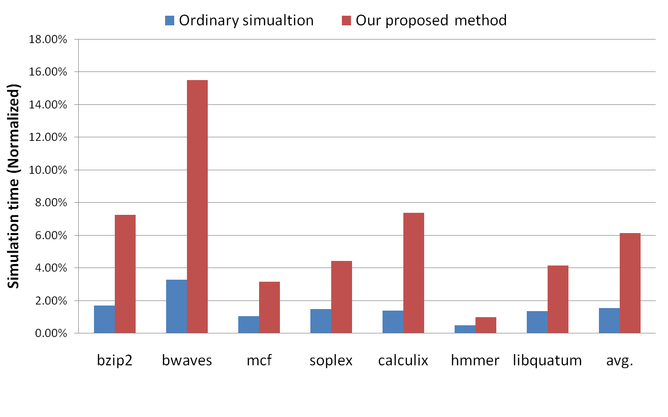
Simulation Time
Require only 6.12% of the simulation time when compared to a full-system simulator.

Slide 57
Outline
Why trace-driven simulation for exploiting architecture designs?
Dependence-aware trace: why and how
Dependence-aware trace-driven simulation for SMP NoC
Dependence-aware trace-driven simulation for GPU NoC
FSM-based trace compression

Slide 58
GPU versus CPU
GPU has following features:
  SIMD (highly parallel)
  Warps switched by hardware
  High bandwidth memory
  Low power
  Short pipeline
  In-order execution and sequential access
Is there any difference between dependence-aware trace for GPU and for CPU?
How effective is dependence-aware trace for the NoC study of GPU?

Slide 59
Evaluation Plan
Focus on NoC of GPU
Difficulties:
  Garnet only models one-way delivery, but SMP has 2-way traffic
  Correspondence of messages at different layers
  Garnet is for CPU, not for GPU
Benchmark
Multi2Sim
(w/ NoC)
Trace
(causality)
Garnet
Network report (Full-system)
Compare
Network report (Trace-driven)

Slide 60
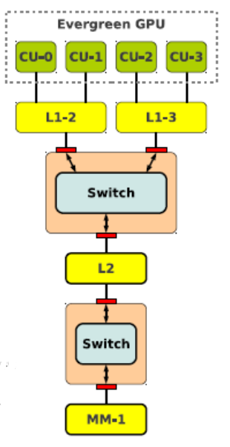
Correspondence of Messages
Processor
New access
End of access
L1 cache
L1 to L2
L2 to L1
L2 to
Global
Global
to L2
L2 cache
Main memory

Slide 61
Enqueue Response Packets from L2
Tracing correspondence between flits, messages, packets
GL1
GDir
Request
Request
Packet
Packet
NetworkInterface_d.cc
Message
Message
Flit
NOC
Flit
Notes:
這張圖是在講我們目前trace到的NOC封包的產生跟結束
一個memory request產生之後會包成 packet，再變成message再切成flit塞入NoC裡面
而目前就是packet轉成封包的時候還沒有抓得很清楚，是我們正在解決的問題。

Slide 62
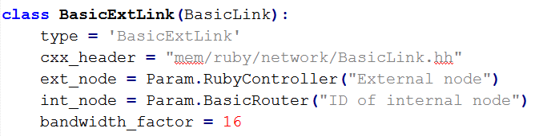
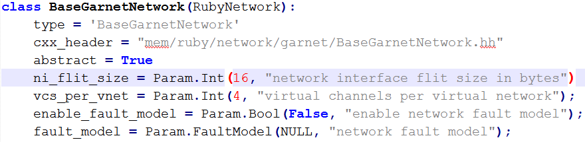
Garnet BW Adjustment for GPU
$GARNET_DIR/src/mem/ruby/network/
  BasicLink.py
$GARNET_DIR/src/mem/ruby/network/garnet/
  BaseGarnetNetwork.py
→264
→264

Slide 63
More Difficulties
Two kinds of L1 cache: scalar cache and vector cache
  Scalar cache stores data for scalar processors which process single data at a time
  Vector cache stores arrays for vector processors which process an array at a time
Memory hiding and trace event dependencies
memory
computing
time
Memory hiding

Slide 64
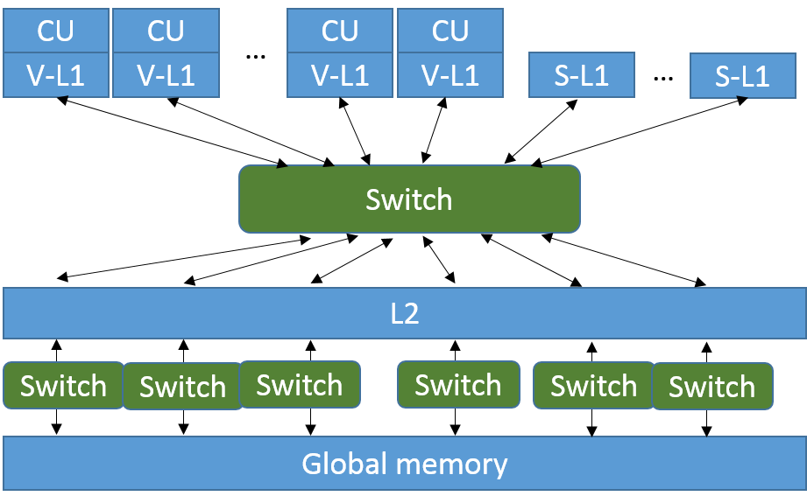
Two Kinds of L1 Caches
NoC simulator must be modified so that each compute unit has two memory access ports, one for scalar cache and the other for vector cache

Slide 65
Memory Hiding Effects
Memory-access barrier instruction to prevent GPU from executing the registers that haven’t been loaded until memory accesses complete
Can record the memory-access barrier in the trace and use such instructions to determine the dependencies among trace events
memory
computing
idle
time
Memory-access barrier

Slide 66
Data Flow Dependencies
s_waitcnt
s_buffer_load_dword s0, s[4:7], 0x04 // 00000000: C2000504
s_buffer_load_dword s1, s[4:7], 0x18 // 00000004: C2008518
s_waitcnt lgkmcnt(0) // 00000008: BF8C007F
s_min_u32 s0, s0, 0x0000ffff // 0000000C: 8380FF00 0000FFFF
s_buffer_load_dword s4, s[8:11], 0x14 // 00000014: C2020914
v_mov_b32 v1, s0 // 00000018: 7E020200
s_buffer_load_dword s0, s[8:11], 0x0c // 0000001C: C200090C
v_mul_i32_i24 v1, s12, v1 // 00000020: 1202020C
v_add_i32 v0, vcc, v0, v1 // 00000024: 4A000300
s_buffer_load_dword s5, s[8:11], 0x04 // 00000028: C2028904
v_add_i32 v0, vcc, s1, v0 // 0000002C: 4A000001
s_waitcnt lgkmcnt(0) // 00000030: BF8C007F
v_mul_lo_i32 v0, v0, s4 // 00000034: D2D60000 02000900

Slide 67
Outline
Why trace-driven simulation for exploiting architecture designs?
Dependence-aware trace: why and how
Dependence-aware trace-driven simulation for SMP NoC
Dependence-aware trace-driven simulation for GPU NoC
FSM-based trace compression

Slide 68
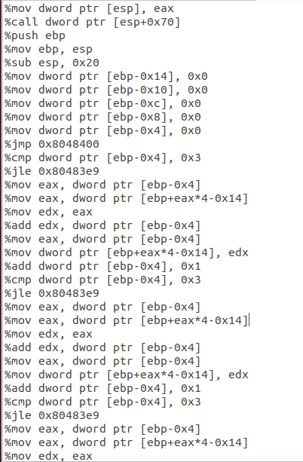
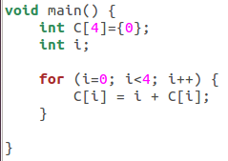
The Problem
Trace
Program
State 1
Dump
Trace
FSM
State 2
Repeat
State 3

Slide 69
Compression Flow
Use trace generator to generate trace
Extract trace pattern
Derive FSM
Weighted random
Pattern table
Track state transitions from merged patterns
Re-generated Trace
Program Finite State Machine
Compressed Trace
Program Execution Trace
Trace generator
Merge patterns

Slide 70
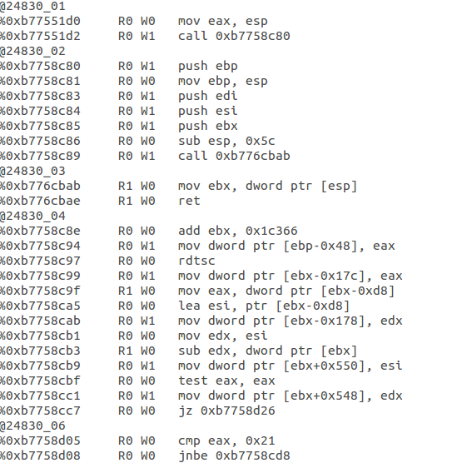
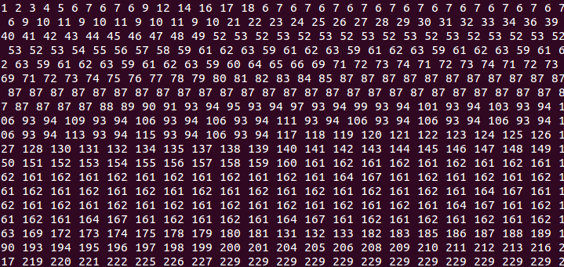
Program Execution Trace
Many methods:
  Simulator/emulator, instrumentation, debugger, profiler
Use basic block ID sequence instead of instruction trace
Whole program
instruction trace
BBL sequence
Filter

Slide 71
Patterns of Basic Blocks for Merging
Sequence of basic blocks can be represented as a long string
  For example, basic block sequence of a 1x2 matrix multiplication program
The goal is to find all the substrings that always appear together in the basic block sequence and as long as possible
1 | 2 | 3 | 4 | 5 | 6 | 7 | 7 | 8 | 5 | 6 | 7 | 7 | 8 | 9 | 10 | 11
4* (1,2,3,4) | 8* (5,6,7,7,8) | 8* (5,6,7,7,8) | 11* (9,10,11)

Slide 72
Derive FSM
FSM greatly reduces size of trace
4* (1,2,3,4) | 8* (5,6,7,7,8) | 8* (5,6,7,7,8) | 11* (9,10,11)
4*
8*
11*

Slide 73
Trace Replay
Use FSM as input to regenerate the trace
  Need to record additional information, e.g., in a state transition pattern table, for replay
    The more information recorded, the closer the regenerated track to the original trace
  Replay by choosing next state based on Markov Chains
4*
8*
11*
State id
Occurrence ordering of future state(s)
Probability of occurrence
4*,8*
8*
8*:1
8*,8*
11*
11*:1

Slide 74
Summary
Introduced the concept of dependence-aware trace
Studied effectiveness of dependence-aware trace for trace-driven NoC simulation for SMP
Discussed how dependence-aware trace may be used in trace-driven simulation for GPU NoC
Outlined how to transform execution trace into FSM for compression and how to replay

